Slide 1
Japanese 日本語 nihongo
Year 9 and 10

Slide 2

Japanese in Year 9 and 10
Practice hiragana and katakana script.
Develop knowledge of kanji script.
Have increasing control of language structures and systems.
Use Japanese in a range of ways.
Enjoy further study of Japanese culture through cooking, dance, creative arts and other activities.
Initiate and sustain interactions with other speakers of Japanese.
Develop broader knowledge of vocabulary and grammar to produce more sophisticated language.
Continue to develop knowledge of Japanese culture through first-hand experiences

Slide 3


Japanese culture and language in Australia and in the world
Japanese culture influences many areas of Australian society, including the arts, design, technology, fashion, popular culture and cuisine.
Japan has been a close strategic and economic partner of Australia’s for more than 50 years, and there is ongoing exchange between the two countries in the areas of education, trade, diplomacy and tourism.
Japan is an important nation within Asia and a significant contributor to economic, political and diplomatic relations in the region.

Slide 4


Learning Japanese
Through learning Japanese, students acquire:
communication skills
an intercultural capability, and an understanding of the role of language and culture in communication
a capability for reflection on language use and language learning.

Slide 5





Features of Japanese Language
Japanese is a phonetic language. Pronunciation is predictable, and new words can be pronounced easily upon mastery of hiragana characters.
Japanese grammar is relatively uniform, with few irregularities, no grammatical gender, and predictable and systematic conjugation of adjectives and verb tenses.

Slide 6


Intercultural Experiences
The curriculum is designed with an intercultural language learning orientation to enable students to participate meaningfully in intercultural experiences, to develop new ways of seeing and being in the world, and to understand more about themselves in the process.
In Year 10, students have the opportunity to join the Japan Study Tour, a 10 day trip for a first taste of Japan.
There are also additional student exchange opportunities available in conjunction with our sister school, Shizuoka Salesio School.

Slide 7





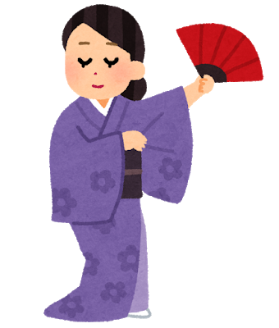

What will I learn?
You will be given the opportunity to:
Develop techniques for learning a second language
Acquire a vocabulary of Japanese topic related words
Participate in guided conversation
Read, comprehend and write basic texts
Experience an introduction to the culture of Japan

Slide 8

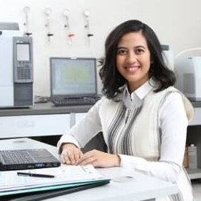

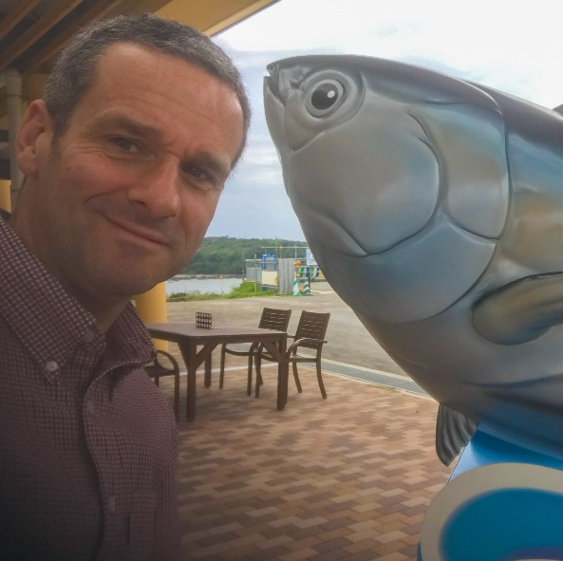
Careers
Learn Japanese and a New World Opens
日本語を知る。世界が広がる。
nihongo o shiru. sekai ga hirogaru.
Japanese can benefit you in a wide range of future careers, including: Gaming and Robotics, Media and Entertainment, Interpreting, Exporting & Importing, Teaching, Sales, Business and Finance, Tourism and Hospitality, Travel and Transport, Foreign Affairs, Retail, Immigration and Customs, Science, Journalism, Military, Sports, Consultancy…
Vanessa Åsell Tsuruga (Sweden)
Sports lover, fluent in Japanese
Senior Manager – Global Sports Digital Strategy at Rakuten (major sponsor of Barcelona FC).
Sastia Putri (Indonesia)
Scientist, fluent in Japanese
Associate Professor at Osaka University, researching metabolomics technology for biofuels and coffee authenticity.
Luke Thompson (New Zealand)
Rugby player, fluent in Japanese
Played for Japan in four Rugby World Cups.
Scott Allen (Australia)
Local small business owner,
fluent in Japanese
Owner of Kinoko Deli and Panko chan.

Slide 9
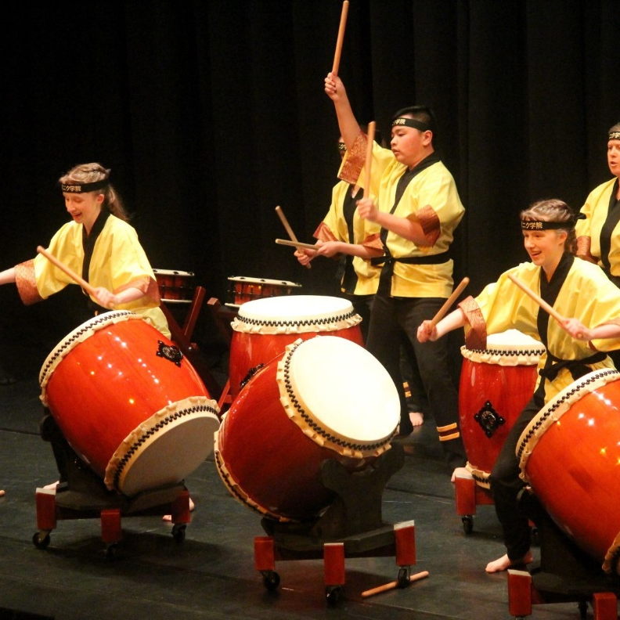
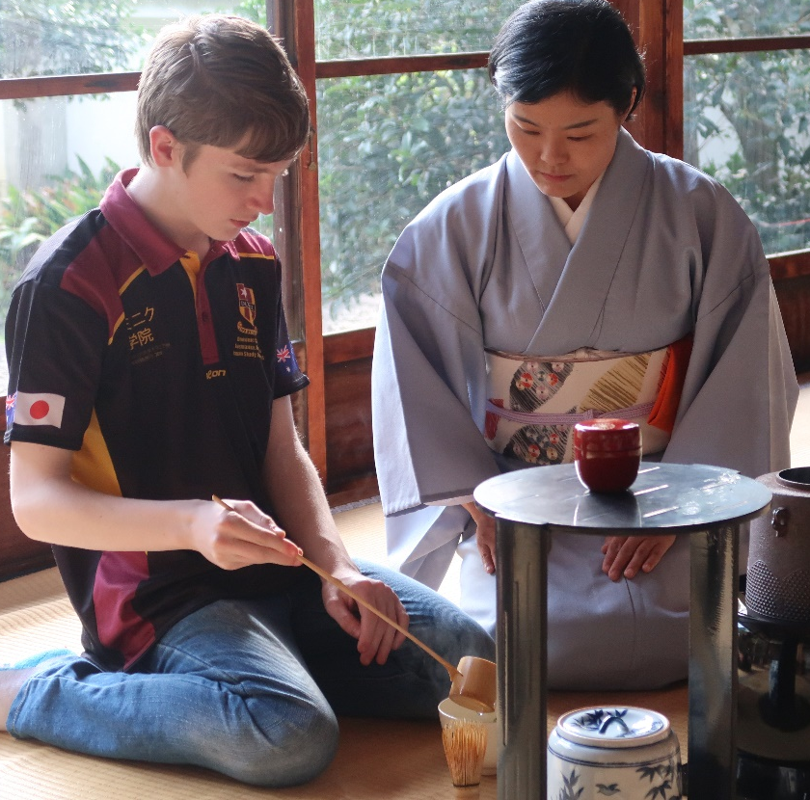
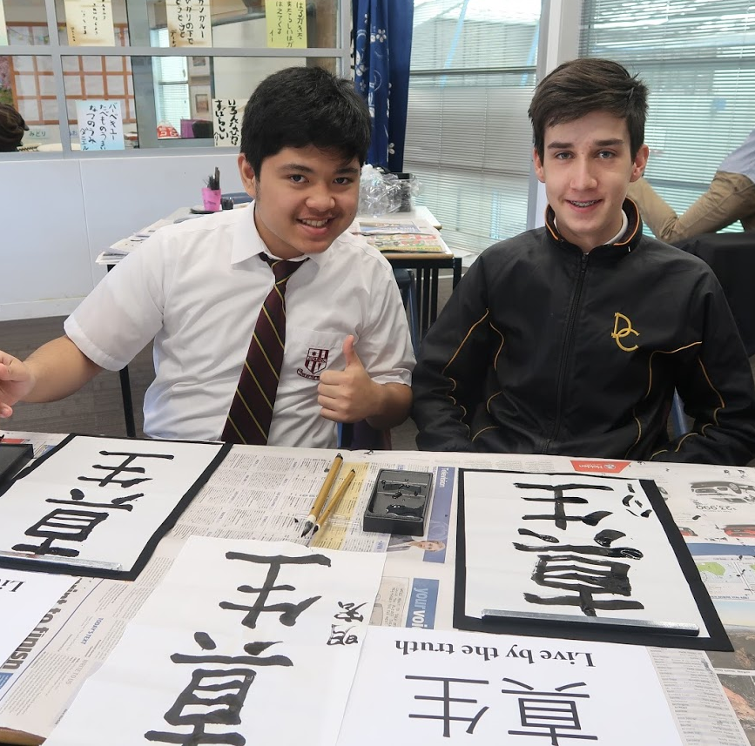
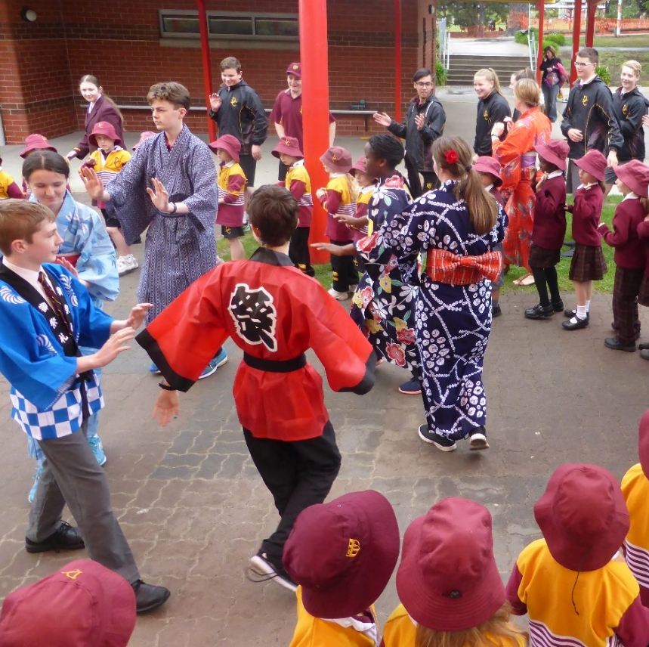
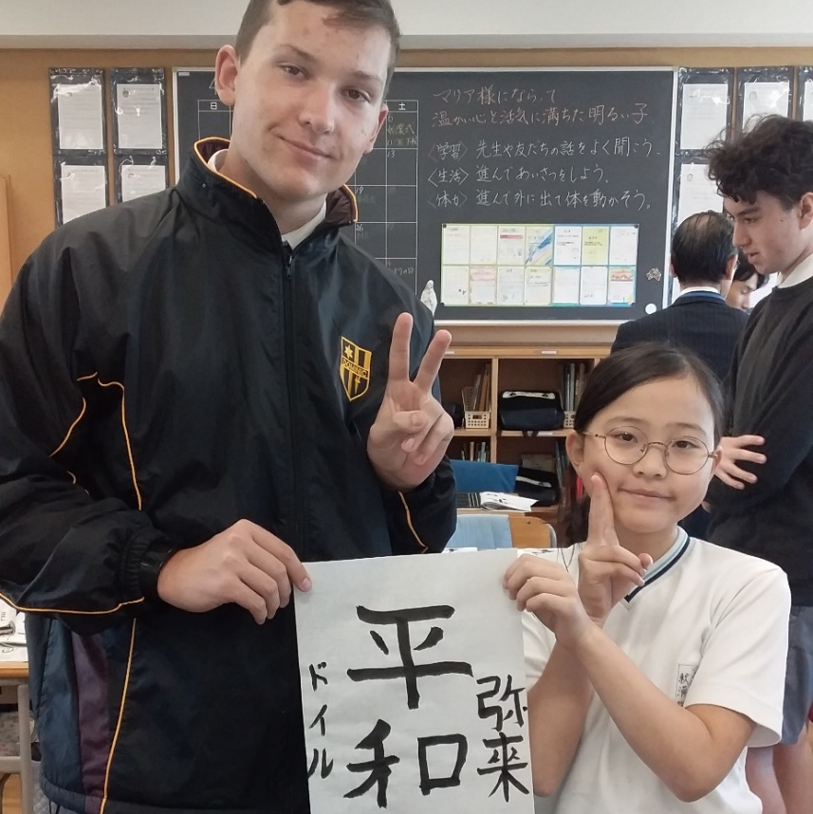
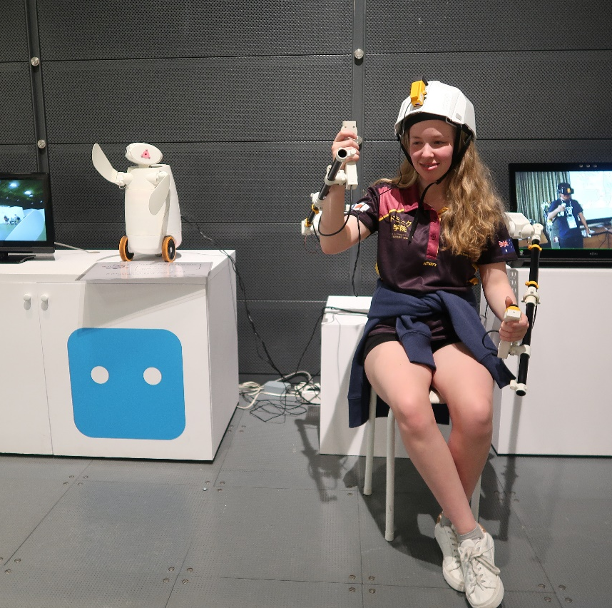
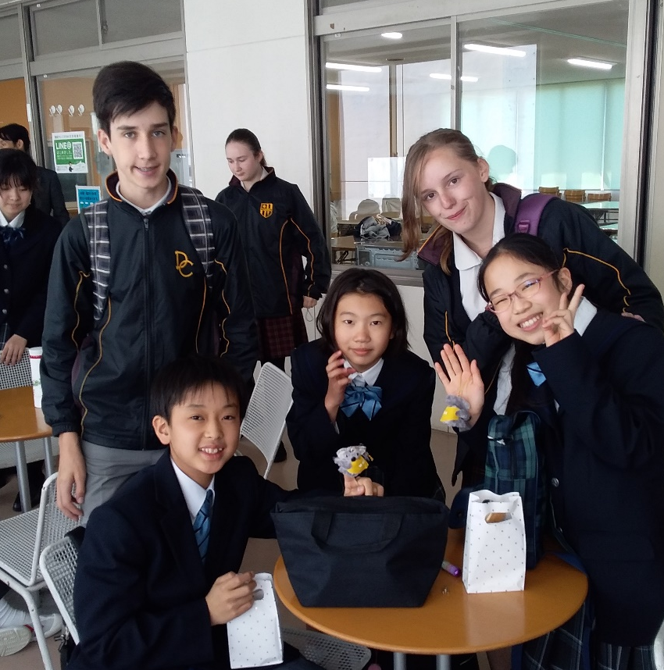
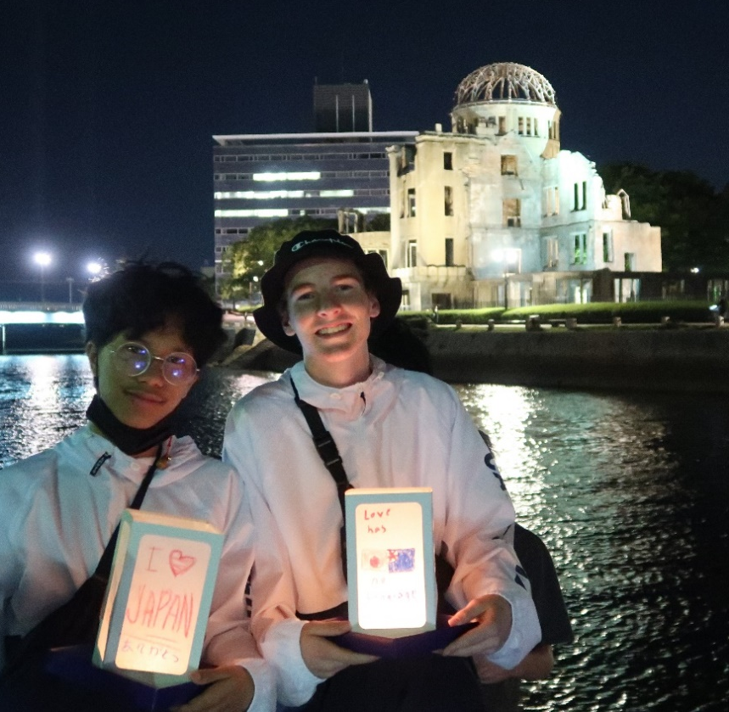
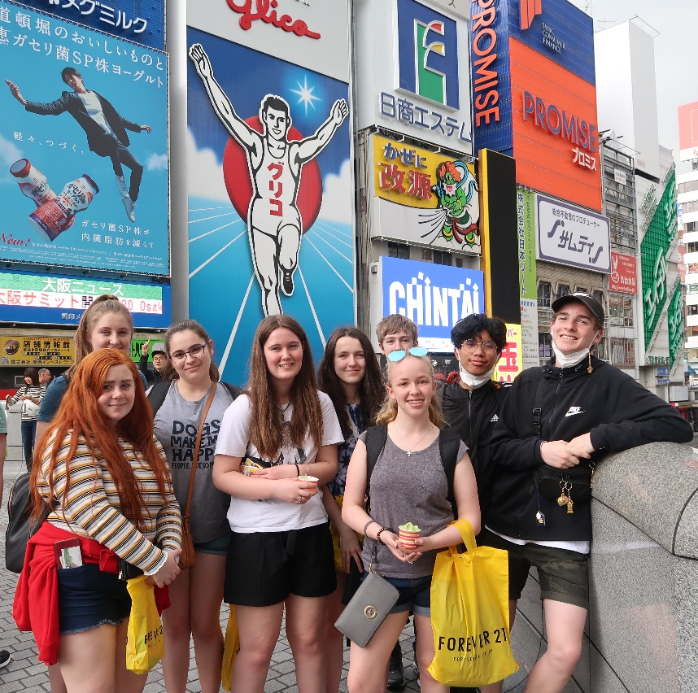
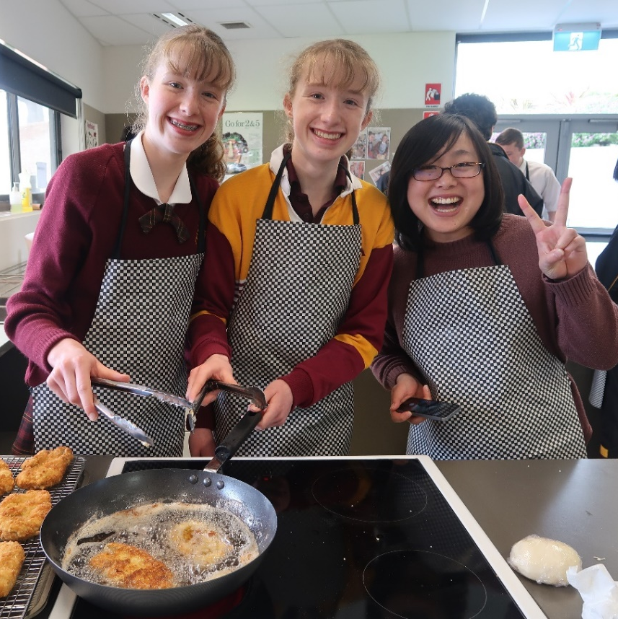
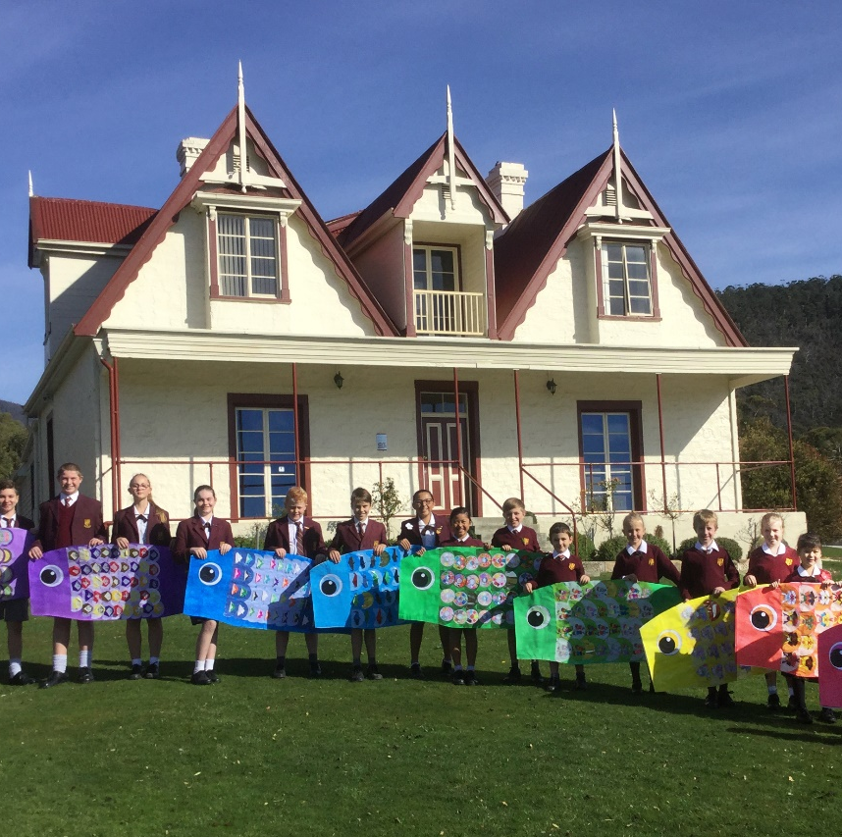
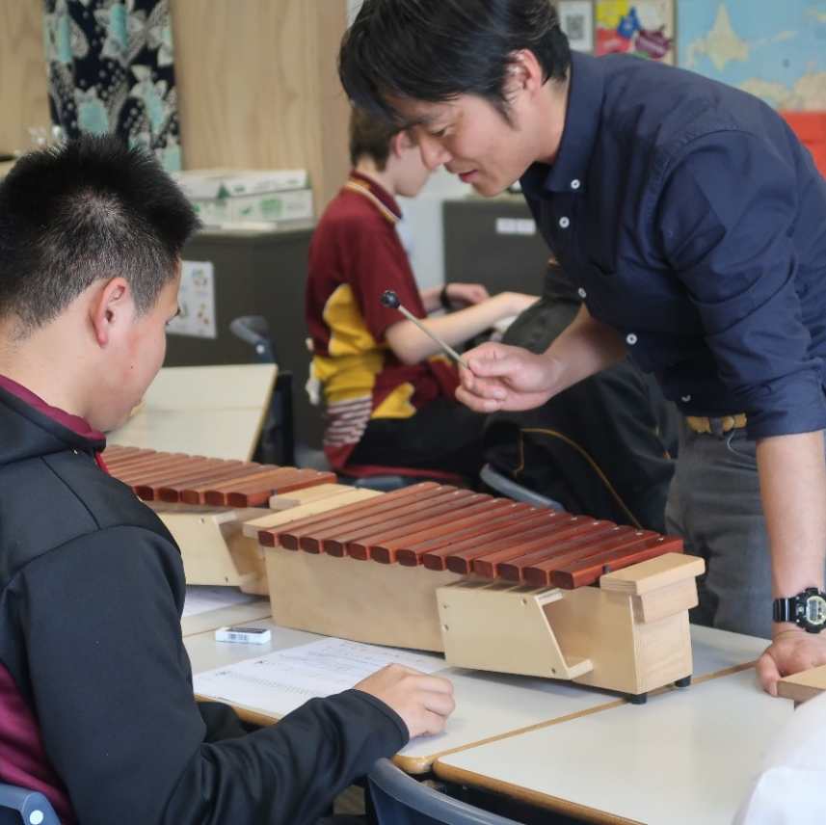

Slide 10
Find out more…
Please feel free to contact Mrs Belinda Kumashiro, Studies of Asia Coordinator, at bkumashiro@dominic.tas.edu.au

